Slide 1

Retail Investments powered by Conversational AI
FinBOT
Conversational AI Research Project
Autumn 2023
November 13, 2023

Slide 2

Agenda
Team Introduction
Product Introduction
Demo
Data Infrastructure
Model Iteration
Next Steps

Slide 3
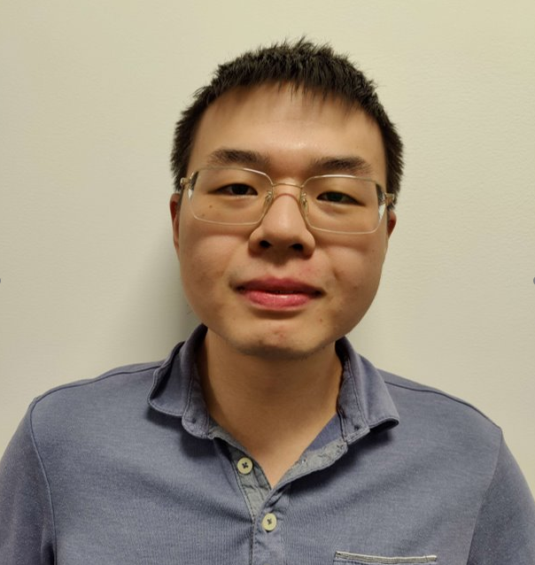




The Team
Shilong Dai
Snigda Gedela
Shefali Gupta
Takuma Koide
Yif Wang

Slide 4
Product Introduction

Slide 5
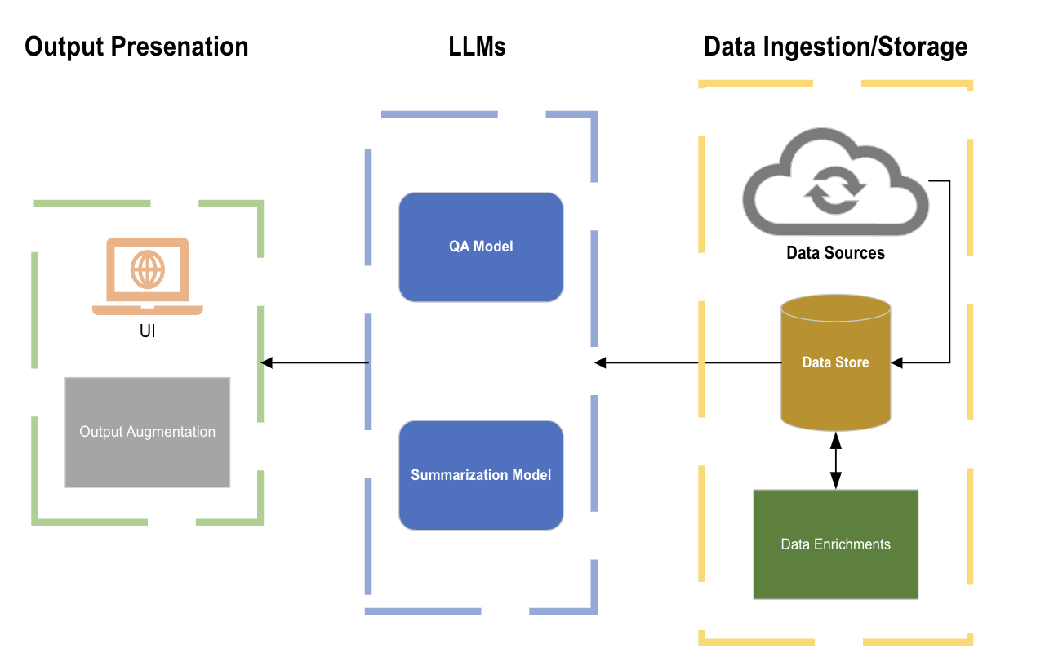
Executive Summary
FinBot takes in user queries and generate answers and key points regarding a company/industry to help user make investment decisions.
User's Query
AI's response
User's follow up
User receives report on the specified format
User asks follow up question on the response received
User specifies the format of response and asks a question

Slide 6

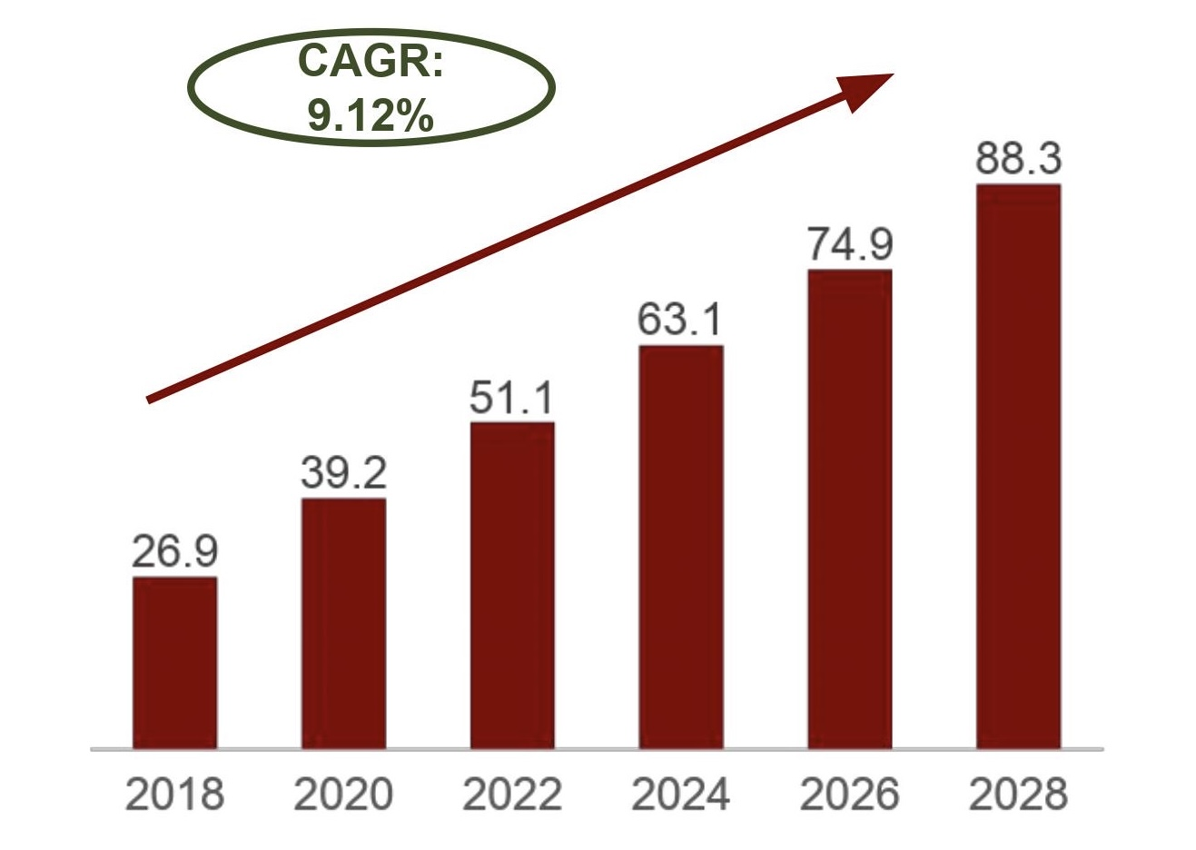

Why FinBot? : Retail investors face major challenges that can be alleviated by Generative AI
As is Scenario of Retail Investors
Market Size Asset Under Management (Trillion $)
Limited time to conduct in depth research and keep up with latest opportunities
High cost associated with financial advisors of few hundred dollars per hour or more
Gen AI with LLM
Gen AI rapidly analyzes vast data sets, offering insights, reducing the need to manually conduct research and seek opportunities
Gen AI-powered tools, provide financial advice at a fraction of traditional costs

Slide 7


An AI driven personal investment assistant, FinBot, can empower retail investors
Functionality
&
Expected Output
Direct QA over News
2. Key-points Summaries
3. Intelligent Stock Screener
What? : Generate direct and concise answers to user queries on business and financial news
Why? : Up-to-date information and saves time
What? : Extract relevant key-points over multiple topics
Why? : Broader awareness outside user's expertise Abstractive Summarization
What? : Intelligently provide key metrics commonly used to identify opportunities
Why? : Identify potential investment opportunities
*Query:
*Time Period:
Direct Answer:
Related to Your Query:
Bullet Point Summary:
Public Stocks:
Stock Price Over Time:
Financial KPIs:
Which companies are working on …
Meta, OpenAI and Google are …
MSFT
AMZN
NVDA
1 month
3 months
6 months
On 2023-08-22, it was reported …
Meta researchers gathered audio...
Source: CNBC.com
The articles mentions several companies that are working on …
Mkt Cap
PE%
Beta
Powered By
Technology
Web Crawler
2. Retrieval Augmented Generation (RAG)
3. Abstractive Summarization
Crawls and augment thousands of news articles
Technique for enhancing accuracy and reliability of Gen AI output
Generates concise summary that captures main ideas of articles
*'Query' and 'Time Period' are user inputs. Other highlighted contents are model outputs
Notes:
Elaborate technology using one more technical sentence

Slide 8
Demo

Slide 9
Data Infrastructure

Slide 10
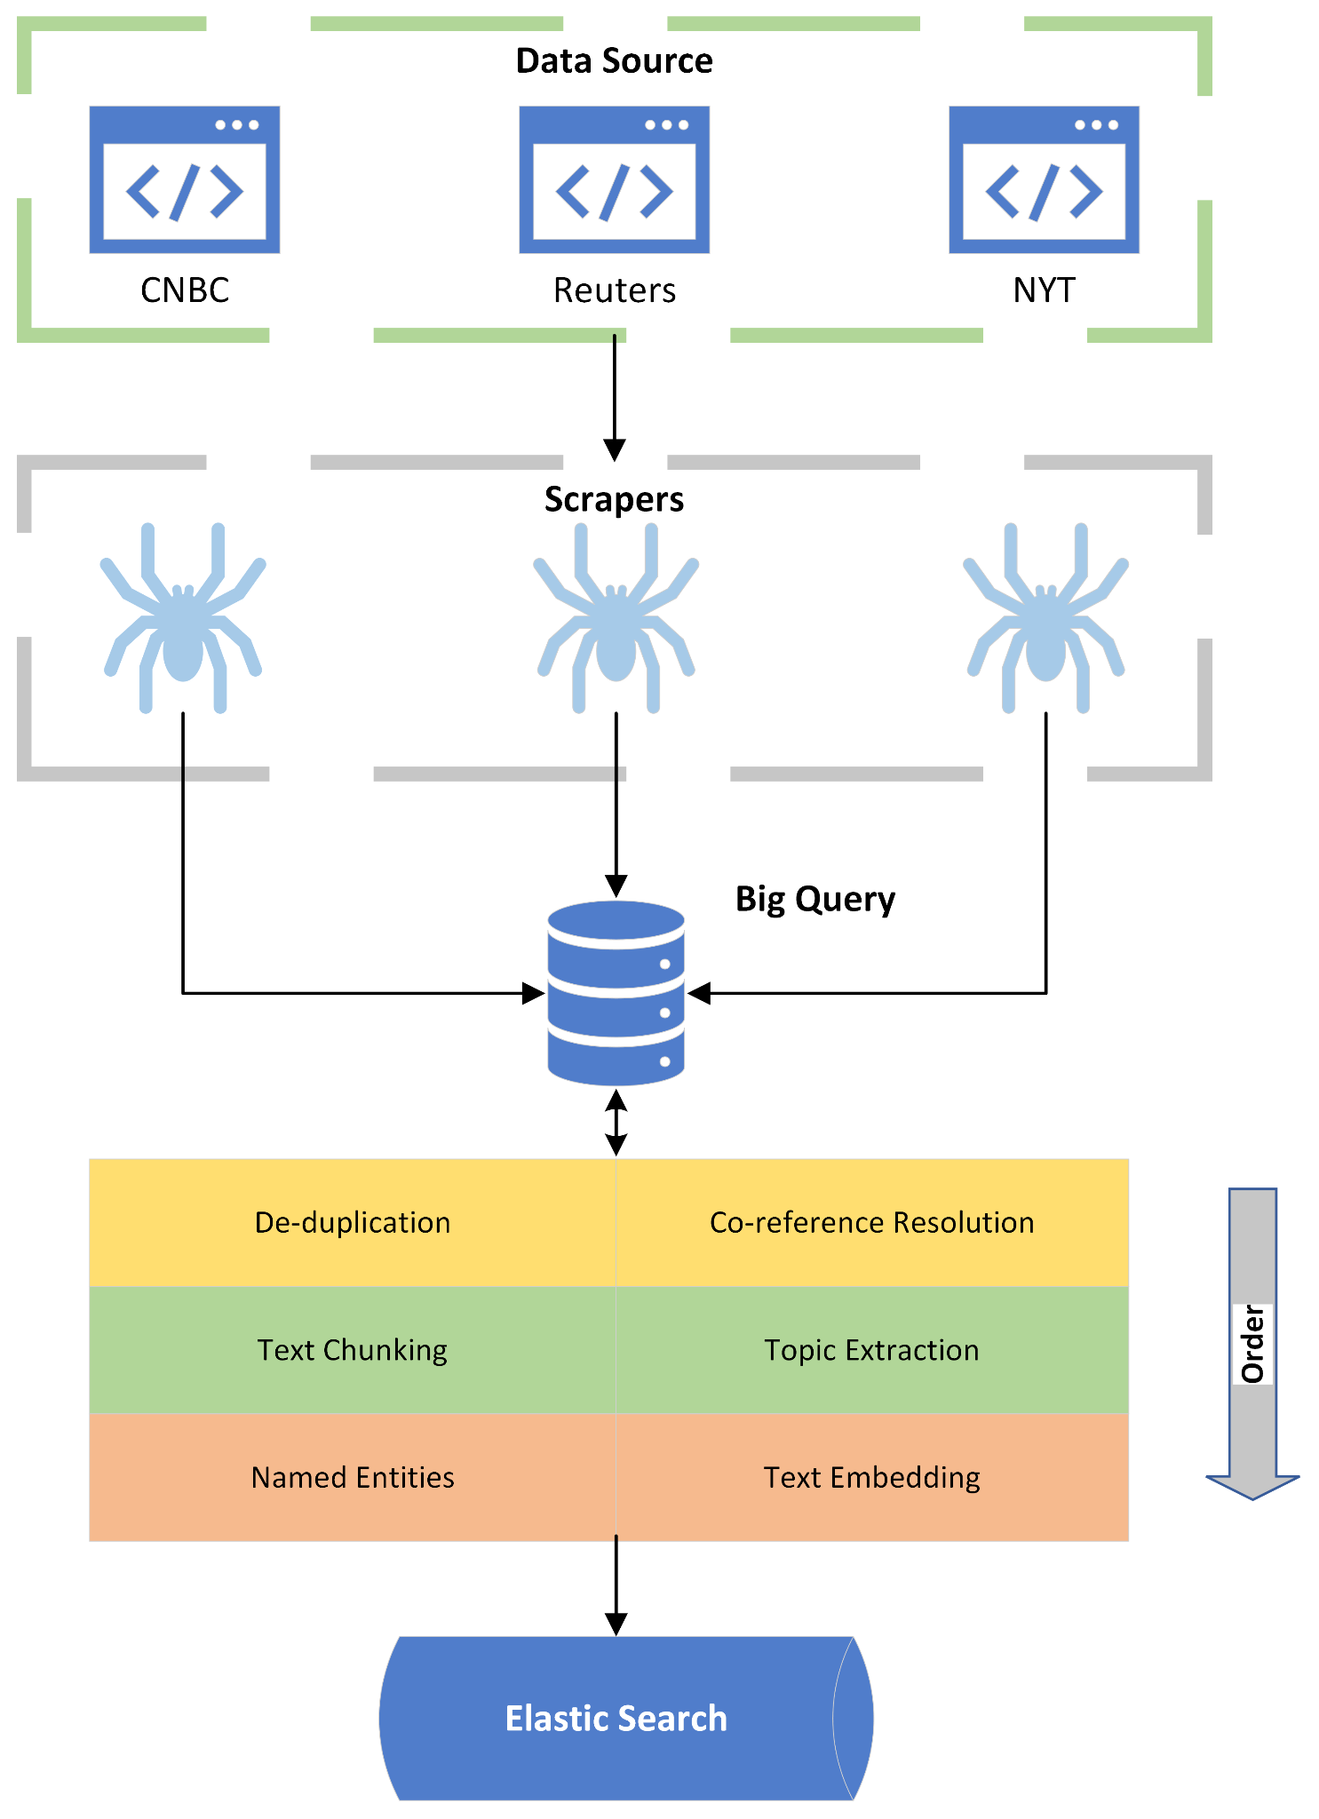
FinBot crawls and augments hundreds and thousands of articles to generate insights
Data Collection
Web crawled articles from prominent news sources, including CNBC, The New York Times, and Reuters
Articles are collected from Mar. 2008 to Oct. 2023
Crawled data is stored in GCS
Data Augmentation
Augmented the articles by applying a series of NLP techniques
Co-reference Resolution,
Topic Modeling
Text Chunking & NER
Embedding
Semantic Index

Slide 11
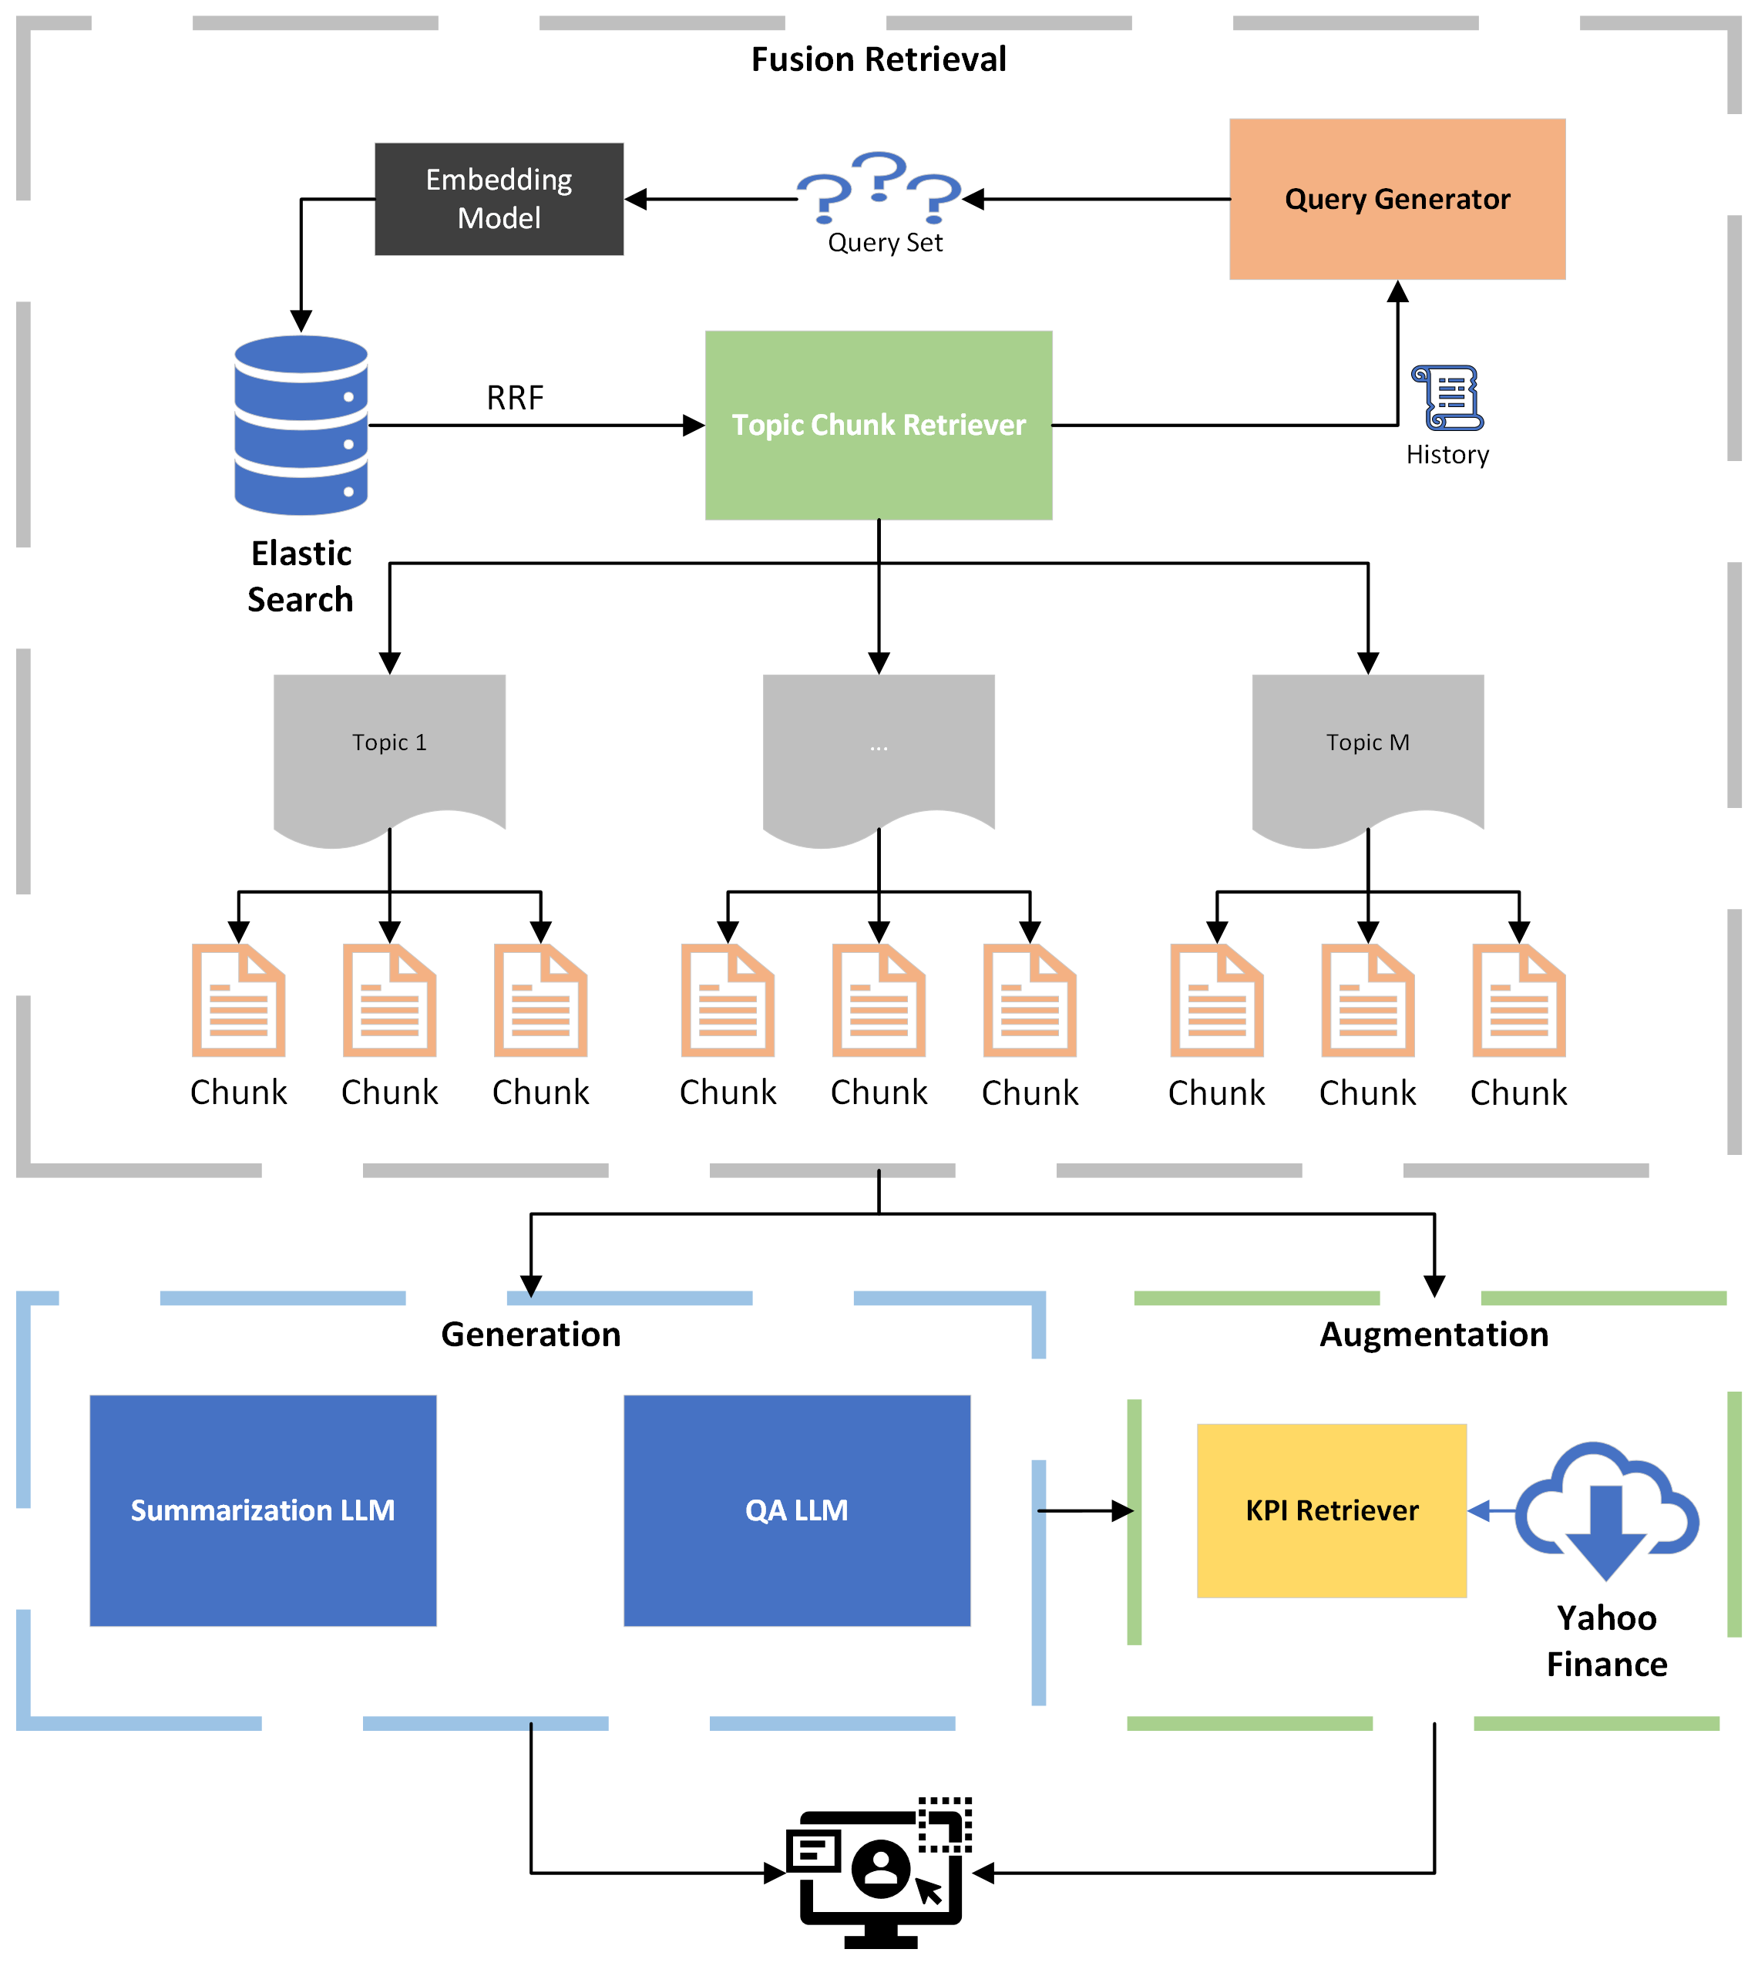
FinBot performs Fusion RAG to produce final insights
Retrieval
A RAG (Retrieval Augmented Generation) is utilized for chunk retrieval
It augments the user query based on interaction history and adds similar queries
Then, for each query, the chunks are retrieved from elastic search using a hybrid RRF search
Generation
Utilized custom-tuned Summarization LLM and
Fine-tuned QA Model is used to directly answer the user query
Enriched text generation by referring to KPI retrieved from Yahoo Finance

Slide 12
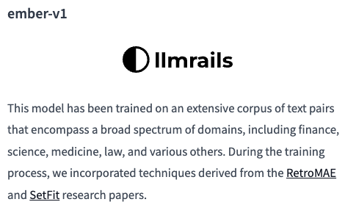

FinBot utilizes the state-of-the-art models as a foundation for text generation
Ember-v1
The Ember-v1 model is used for creating the embeddings for retrieval
It is known as the best non-instructed tuned embedding model for retrieval task on the HuggingFace MTEB Leaderboard
Covers various domains including Finance
Llama-2 13B and Open-Orca Mistral-7B
Open-Orca Mistral-7B is used as a foundation for key-points summarization
Achieves top performance among models ~7B for LLM tasks
Generates more similar summaries compared to human written summaries than Llama-Chat
Llama-Chat-13B is used as the basis for generating concise QA answers
One of the most popular model family

Slide 13
Model Iteration

Slide 14
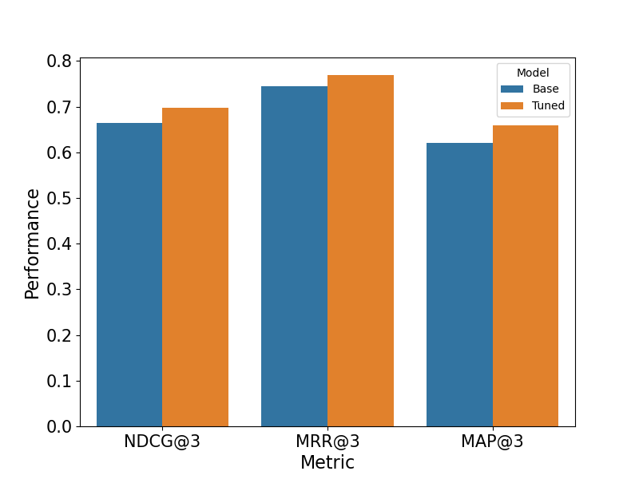
The embedding model was aligned via contrastive learning to improve retrieval performance
Data Selection
Performance
The FIQA dataset
30K finance related questions and answers scraped from QA forums
Data augmented with PaLM2 to make the tone formal
Tuning Process
Contrastive learning with Multiple Negative Ranking Loss
Minimizing dissimilarity between question/answer vectors
Notes:
RAG approach was used, and an important part of the ranking process in the retriever is vector similarity
Ranks article chunks by similarity of its embedding vector with the embedding vector of the query
One way to improve retrieval is to tune the Ember-v1 model that generates the embeddings
Sourced the FIQA dataset consisting of question and answer pairs scraped from financially related QA forums such as stocktweets and relevant sections of stackexchange
QA forum -> informal responses
Applied PaLM2 model to rewrite the answers so that it matches the tone of news articles
Tuned the Ember-v1 model with contrastive learning
Minimizes the distance between the embedding vector of question and answers
Keeping vectors between unrelated questions and answers distant
Evaluated model on a test set with 2.5K entries
Several information retrieval metrics used
Measures whether the top 3 retrieved answers contains the ground truth relevant answers discounted by rank in the result
Achieved a few percentage of improvements across all metrics despite the Ember-v1 model having seen finance related data

Slide 15
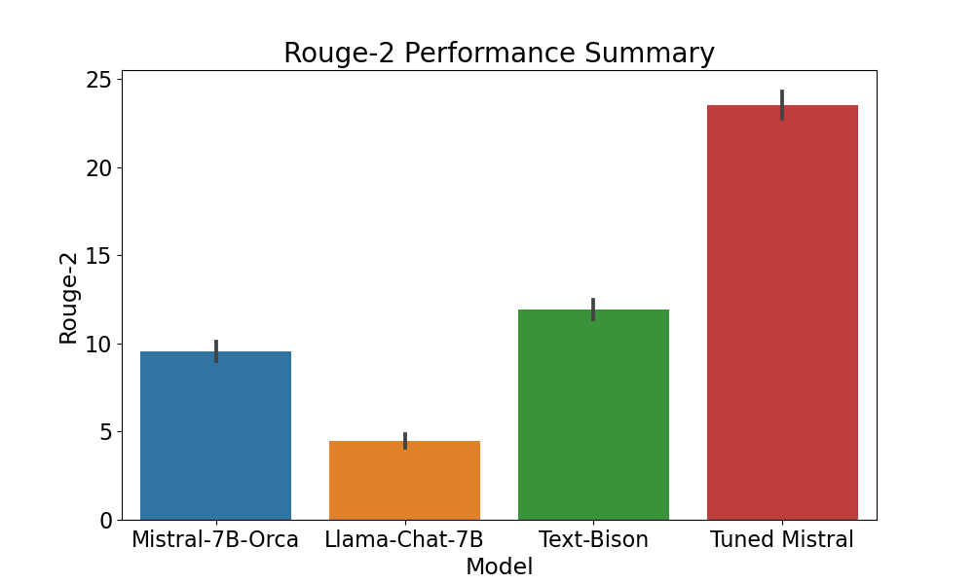
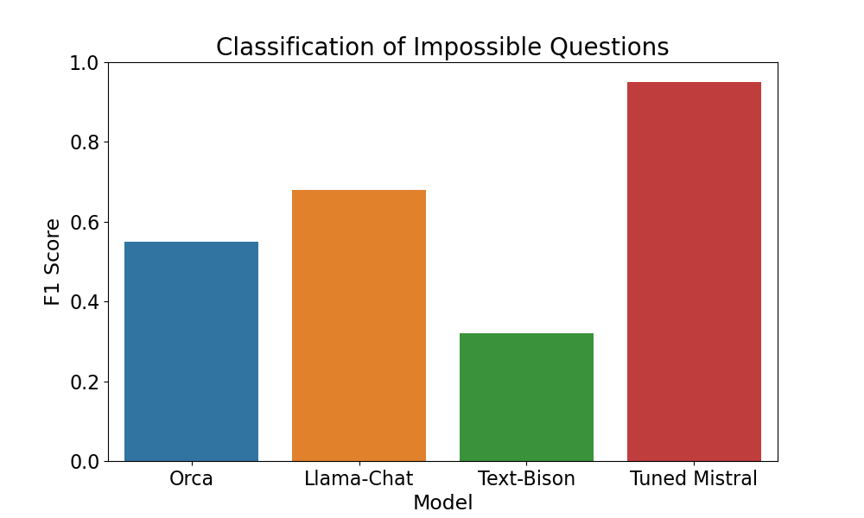
Human written key-points from scraped articles were used to improve the target summary model
Mimicking Human Key-points
Targeted Summarization
Mistral-7B tuned on human-written key-points
Roughly 35K articles with appropriate key-points
Mostly sourced from Reuters and CNBC
Data adjusted to improve readability
Injected published date information
Generated tagline over key-points
Data augmented with potential questions
A pair of answerable and unanswerable question
Classification of unanswerable question
Noise were injected by adding random chunks and shuffling chunked context
Achieved F1 score of 0.95
Notes:
Concise key-points in specific format via fine-tuning Mistral-7B model for targeted summarization
Out of all scraped articles, filtered down to 35K articles with relevant key-point summaries in desired format
Reuters and CNBC
Data augmentation was applied to ensure that the model outputs text suitable for RAG and our use-case
Applied coreference resolution so it's similar to the chunks in production setting
Added published dates to the summaries and generated appropriate tagline over the key-points using the PaLM2 model
In addition, re-wrote some summaries by incorporating entities from titles of the article if summary not clear
Then, for each summary in the data, generated a question that's possible to answer and one that's impossible to answer using only the summary
Targeted summarization
Ensuring that the model can determine if question can be answered
Finally, noise mimicking the RAG context was injected by chunking the source articles, adding random chunks from other articles, and shuffling the resulting chunks
Pick out the relevant chunks for targeted sumarization and stay concise
Tuned model achieved significant improvements over baseline models and even the PaLM2 with one-shot example on a test set with 2K entries
Rouge-2 score: Measures similarity between generated key-points and human-written key-points. Measures overlaps in consecutive word pairs.
F1 score: Models ability to classify impossible to answer questions. 95% F1 for the fine-tuned model so it is much less likely to hallucinate

Slide 16
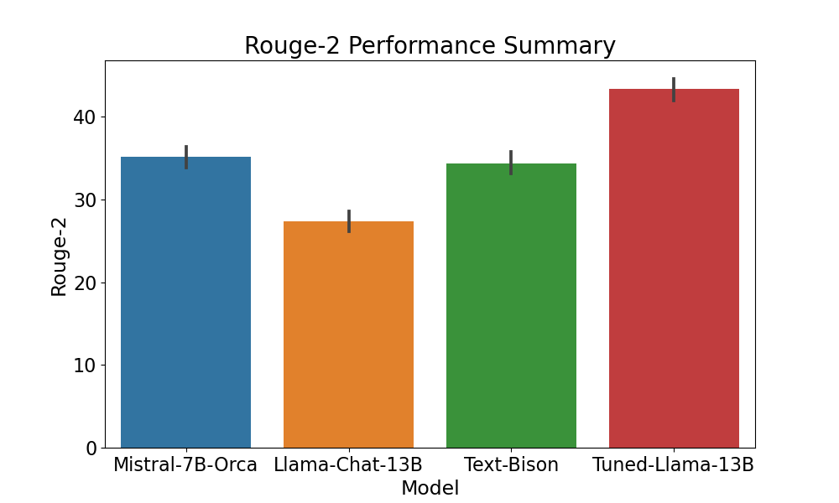
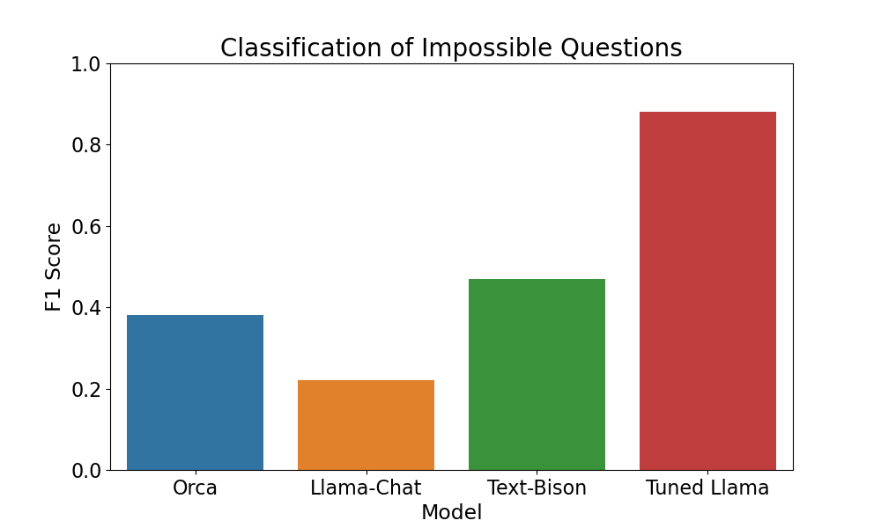
QA model was lightly fine-tuned using RAG specific datasets
Generating Consistent Outputs
Noise Injection
Llama-Chat-13B tuned on 20K QA pairs with contexts
Finance related texts from TAT-QA/FINQA
General texts from WebGLM QA
Concise responses in under one paragraph
Data adjusted to match RAG settings
Shuffled and mixed context chunks
Source datasets did not contain unanswerable questions
Added 10% randomly chosen pure noise context with sampled questions
Achieved F1 score of 0.9 with 1 epoch of tuning
Notes:
Finally, we were happy with the content of QA model output, so we just wanted to lightly tune it to change the output style to be more consistent
Sourced total of ~10K data entries from TAT-QA, FINQA, and WebGLM QA datasets all with concise responses
TAT-QA and FINQA has financially related questions
WebGLM is general purpose QA with context, added it for transfer learning and also to make sure that the model doesn't catastrophically forget
Similar approach for adding noise from the summarization model
However, only added 10% of pure noise contexts since we want to focus more on the conciseness of the output
Tuned model achieved some improvements over the baseline models, and also gained more ability to understand when a context is noise with respect to question

Slide 17
Final Thoughts

Slide 18



Conclusions
Product
Solution
Methodology
FinBot is a state-of-the-art AI driven financial assistant that empowers the retail investors by allowing them to make more informed decision on their own assets
Our solution provides comprehensive market research to the users by utilizing retrieval augmented generation(RAG) over financial news articles
Each component of RAG was improved and aligned by fine-tuning over financially related datasets

Slide 19
Next Steps
Phase I: Performance Optimization
Phase II: Product Deployment
Timeline:
2 - 3 weeks
1 - 2 months
Phase 1.1:
RAG
Phase 1.2:
Question Answering
Phase 2.1:
Follow-up Questions
Phase 2.2:
Data Ingestion & Production
Further improve RAG performance by distorting the data
Try more QA reading comprehension model and compare with the current models e.g. LLama 70B
Provide insights and recommendations based on user query and settings
Incorporate intelligent filtering of KPIs from Yahoo Finance
Improve efficiency of data ingestion
Look for initial user feedback for further iterations

Slide 20
Thank You

Slide 21
Appendix

Slide 22
Next Steps
Performance Optimization – Distorting the RAG data,
We can continously monitor common questions by the users and add more data for those queries in the RAG dataset.
We can try more bigger QnA models
More features:
In addition to answering questions, we can add a feature of recommending investments ideas after having observed user's queries and using KPI from yahoo finance.
We can look into improving the data ingestion by using BIG data platforms for distributed computing

Slide 23
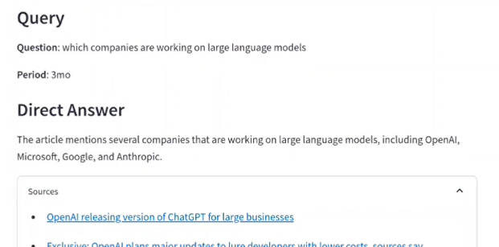
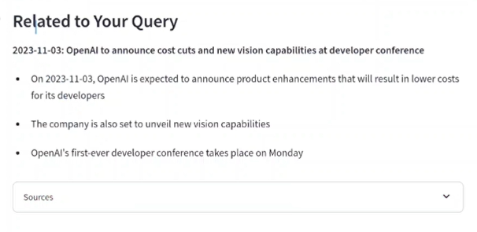
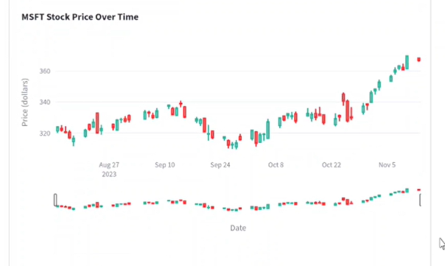
An AI driven personal investment assistant, FinBot, can empower retail investors
Direct QA over News
What? : Generate direct and concise answers to user queries on business and financial news
Why? : Up-to-date information and saves time
1
2
2. Key-points Summaries
What? : Extract relevant key-points over multiple topics
Why? : Broader awareness outside user's expertise
3
3. Intelligent Stock Screener
What? : Intelligently provide key metrics commonly used to identify opportunities
Why? : Identify potential investment opportunities

Slide 24
Tuning Performance of Embedding Model
Data Details
Performance
Data Sizes:
Train: 28K pairs of question and answers
Eval: 2.5K pairs of question and answers
Test: 3.4K pairs of question and answers
Data Augmentation:
GPT-Turbo-3.5
"You are … that will re-phrase given text into a formal tone found in news articles or financial reports … never add any new information to the given text ..."
Removed unassociated questions and answers
Metric@3 | Base Model | Tuned Model
Accuracy | 0.81 | 0.83
Precision | 0.58 | 0.62
Recall | 0.44 | 0.46
NDCG | 0.66 | 0.70
MRR | 0.74 | 0.77
MAP | 0.62 | 0.66
Tuning Details
Sentence transformer approach
Classify one positive pair per batch
Other pairs in batch negative
Soft-max with input based on vector distance
Batch size of 32 with learning rate of 0.0001

Slide 25
Tuning of the LLMs
Summarization Data Details
QA Data Details
Data Sizes:
Train: 77K context and key-points pair after augmentation
Test: 2K context and key-points pairs
Other Augmentations
Filtered out articles with irrelevant key-points
Current stock trend or other information easily acquired from screener
Added noise-only context with randomly picked questions
Retained original as well as augmented data
Data Sizes:
Train: 20K context with Q/A after augmentation
Test: 2K context and key-points pairs
Data Mixes
~5K entries in TAT-QA after filtering
Added 1K entries from FINQA
Mixed in ~5K data points from WebGLM QA
Augmentation
Total of ~10K entries of same Q/A but shuffled/randomized contexts
Infrastructure
LORA based fine-tuning
Reduced rank of blocks to 16
Lead to < 1% parameters that needs to be tweaked
Tuning with learning rate of 0.0001, and effective batch size of 8
Half-precision training and final weights
Tensor and pipeline parallelism with sharded weights via DeepSpeed
Model served with PagedAttention and tensor parallelism via VLLM

Slide 26
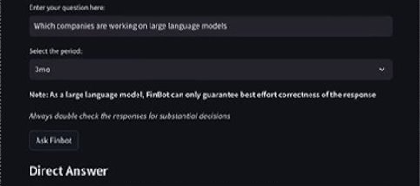

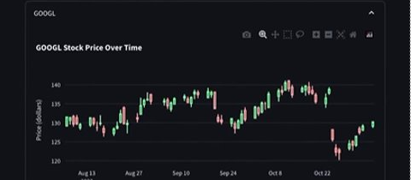
An AI driven personal investment assistant, FinBot, can empower retail investors
Direct QA over News
Generate direct and concise answers to user queries on business and financial news
Users can get up-to-date information without going through many articles
Saves time so user can conduct more research on investment
Key-points Summaries
Extract relevant key-points over multiple topics
Users can become aware of big pictures outside of their expertise
Reduces information asymmetry that may causes the user to miss opportunities
Intelligent Stock Screener
Intelligently provide key metrics commonly used to identify opportunities based on query and output
Users can easily identify potential investment opportunities without going out of FinBot
Improves QoL when using the product

